Slide 1
Optimal Hub Placement and Deadlock-Free Routing for Payment Channel Network Scalability
¹Lingxiao Yang, ¹Xuewen Dong, ²Sheng Gao, ³Qiang Qu
¹Xiaodong Zhang, ⁴Wensheng Tian and ¹Yulong Shen
¹Xidian University
²Central University of Finance and Economics
³Chinese Academy of Sciences; Huawei Cloud Tech Co., Ltd
⁴Nanhu Lab
Presentation for ICDCS 2023
Notes:
Hello, my name is Lingxiao Yang. I am honored to attend this conference and to present our work on behalf of Xidian University. The title of our paper is: Optimal Hub Placement and Deadlock-Free Routing for Payment Channel Network Scalability

Slide 2



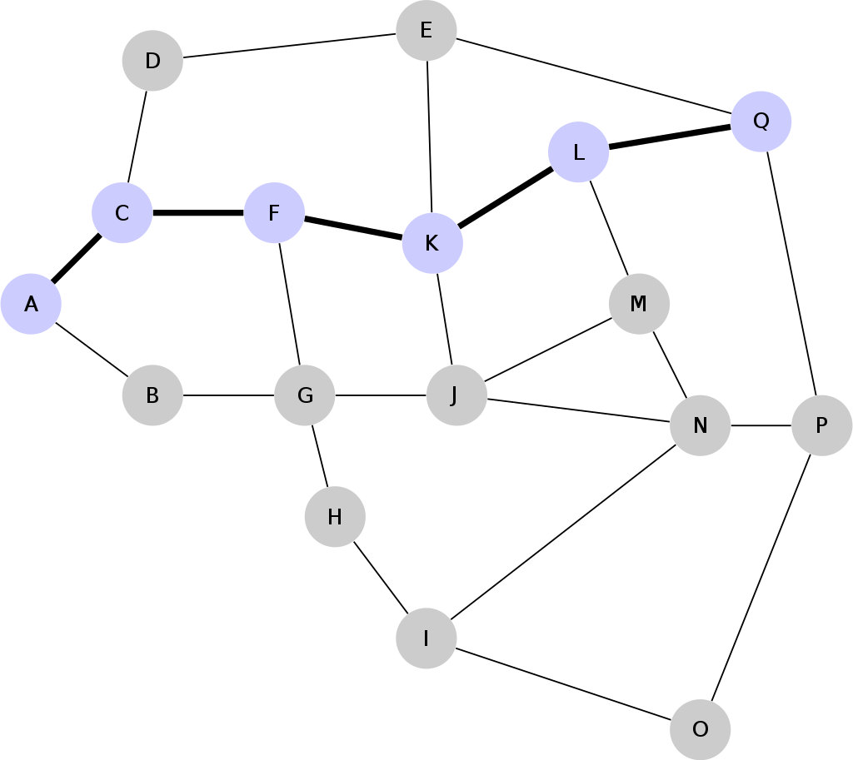


Introduction
Payment Channel Network (PCN)
Layer-2
An off-chain technique to improve the blockchain’s scalability
Blockchain (Layer-1)
Senders
Receivers
① Lock
⑤ Dispute
& on-chain
S₁
R₁
Contract
S₂
Hub
R₂
② Create channel
④ Settle
off-chain Txs
…
…
S_{n}
R_{n}
Layer-2
B
A
Payment channel
③ Execute multiple
off-chain Txs
PCN
PCH
Notes:
Now, I first introduce the background of our work. It belongs to the payment channel network (or PCN) domain of the second layer of blockchain (layer-2), namely, an off-chain technique to improve the blockchain‘s scalability. The transaction process in the off-chain payment channel takes roughly five steps. ① First the blockchain participants lock some tokens on the smart contract for use in the off-chain payment channel. ②After confirming the locked tokens, the smart contract creates a payment channel for the participant. ③Participants can execute multiple fast off-chain transactions in the channel. ④Participants initiate settlement of off-chain transactions to the smart contract. ⑤ Finally, if the on-chain challengers do not dispute the settlement results, the off-chain transaction results are synchronized to the blockchain. Multiple payment channels between multiple users form a payment channel network. Finally, a Payment Channel Hub (PCH) connects senders and receivers in a PCN, and it improves payment routing efficiency and privacy.

Slide 3
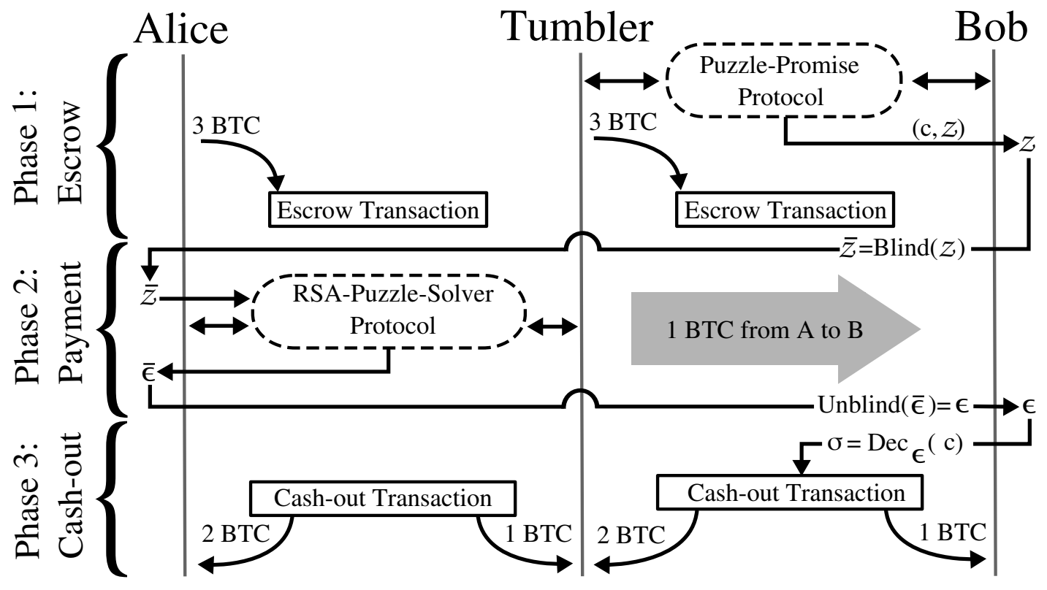
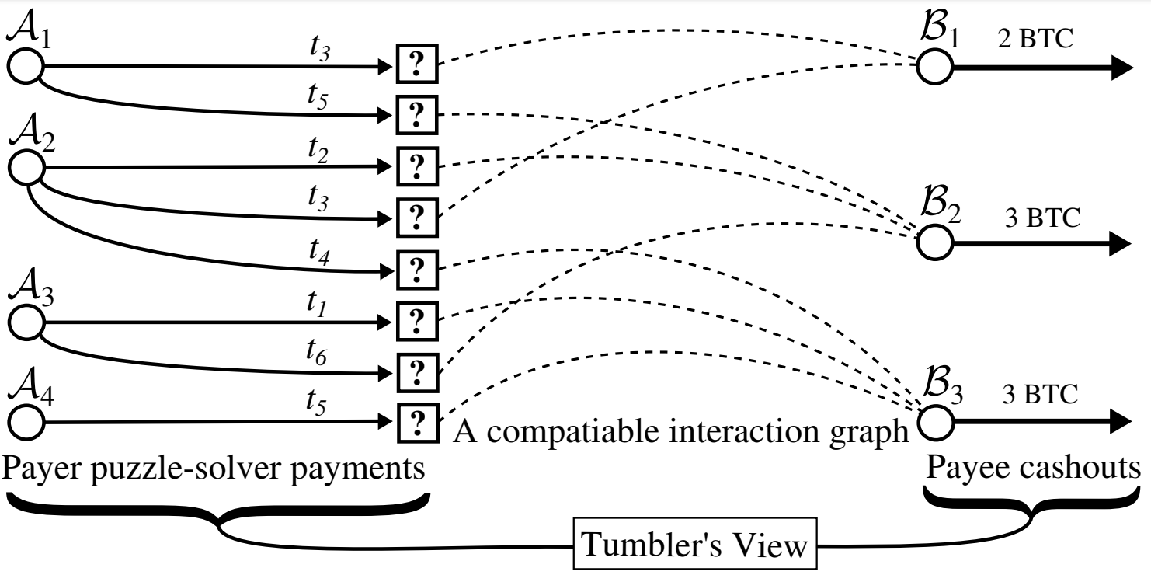
Introduction (cont. 1)
TumbleBit [1]: the first payment channel hub (PCH) for off-chain PCNs
Tumbler acts as an intermediary service through an anonymous payment hub
PCH disrupts multiple payers and payees, with payments going to the pool first, then randomly rotating and disrupting payments to payees
Fig. 1. Overview of the TumbleBit protocol.
Fig. 2. The unlinkability definition: The Tumblers view and a compatible interaction multi-graph.
[1] E. Heilman, et al,“Tumblebit: An untrusted bitcoin-compatible anonymous payment hub.”in NDSS, 2017.
Notes:
Then, we outline three work related to Payment Channel Hubs. The first paper is TumbleBit, which was published in NDSS 2017 and first proposed the PCH, called Tumbler. It provides intermediary services as an anonymous payment hub. TumbleBit proposes to use PCHs as an intermediary service, disrupting multiple payers and payees, with payments first going to a pool of funds, and then randomly rotating and disrupting payments to payees, thus enabling a Layer-2 anonymous payment channel.

Slide 4

Introduction (cont. 2)
BlindHub [2]: Bitcoin-Compatible Privacy-Preserving Payment Channel Hubs Supporting Variable Amounts
Q: All the current bitcoin‑compatible PCH protocols require the amount to be fixed
Fixed amount
Sender
BlindHub
Receiver
The first Bitcoin-compatible PCH that achieves relationship anonymity and variable amounts for payment
BlindChannel, a novel bi-directional payment channel protocol for privacy preserving payments, where one of the channel parties is unable to see the channel balances.
BlindHub, a three-party (sender, tumbler, receiver) protocol for private conditional payments (BAS, FBCS)
BlindChannel
Fig. 3. Overview of BlindHub.
[2] X. Qin, et al,“BlindHub: Bitcoin-Compatible Privacy-Preserving Payment Channel Hubs Supporting Variable Amounts.”in S&P, 2023.
Notes:
The second related paper is BlindHub, which was published in S&P 2023. It addresses the problem that all current Bitcoin-compatible PCH protocols require a fixed amount, and proposes the first Bitcoin-compatible PCH scheme that achieves relationship anonymity and payment amount variability. They first propose a BlindChannel, a novel bi-directional payment channel protocol for privacy preserving payments, where one of the channel parties is unable to see the channel balances. Then, they propose BlindHub, a three-party (sender, tumbler, receiver) protocol for private conditional payments. They introduced two new cryptographic primitives as building blocks for BlindHub, namely Blind Adapter Signature (BAS) and Flexible Blind Conditional Signature (FBCS).

Slide 5
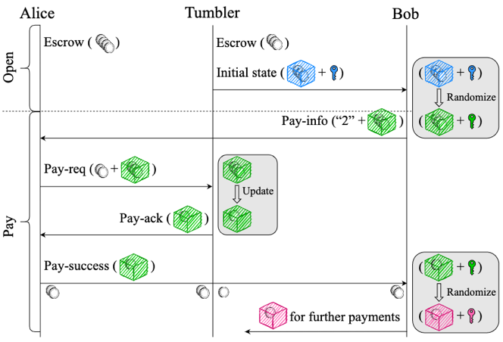
Introduction (cont. 3)
Accio [3]: Variable-Amount, Optimized-Unlinkable and NIZK-Free Off-Chain Payments via Hubs
Q1: Most existing hub-based off-chain channel network solutions can only protect trader identity privacy for a fixed transaction amount
Q2: The variable amount schemes rely on structure-specific ZK-proofs, introducing significant computational & communication overheads
To achieve hidden, updated, and randomized channel states and to remove the dependence on costly ZK-proofs, they propose a randomizable signature primitive for updatable commitments that achieves the desired functionality with low computational & communication overheads
Fig. 4. Overview of Accio.
[3] Z. Ge, et al,“Accio: Variable-Amount, Optimized-Unlinkable and NIZK-Free Off-Chain Payments via Hubs.”in CCS, 2023.
Notes:
The third related paper is Accio, which was published in CCS 2023. Accio also addresses the problem that most existing hub-based off-chain PCN solutions can only protect the identity privacy of traders at fixed transaction amounts, while variable amount solutions rely on structure-specific ZK proofs, introducing significant computation and communication overhead. They propose a randomizable signature primitive with updatable commitments to reduce computational and communication overhead while enabling hidden, updated and randomized channel states and removing the dependence on costly ZK verification.

Slide 6
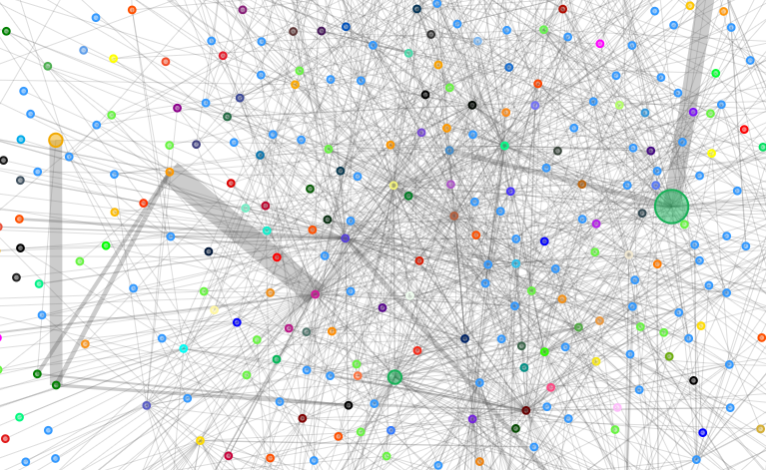
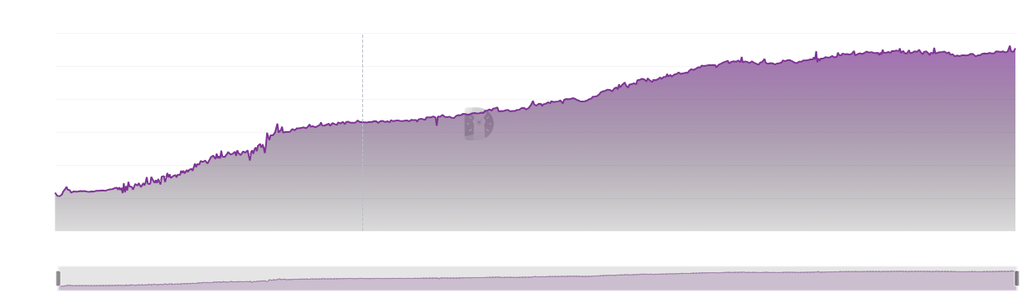




Motivation
Why would we study the optimal PCH placement problem and deadlock-free routing ?
The overall load of PCN rises rapidly and load imbalance occurs gradually
The inappropriate placement of PCHs can easily lead to an unbalanced network load
Existing source routing strategies are performance-challenged for payers and prone to deadlocks
BTC
Senders
Receivers
5k
Crash
Load Rises Rapidly
Load Imbalance
Improper placement → Deadlock
1k
Time
2021.4
2022
2023
Total Value Locked in LN
Lightning Network Visualization
Source Routing Crash
Notes:
Next, I describe the motivation for our work. Why do we study the optimal PCH placement problem and deadlock-free routing? As the frequency of PCN usage increases, its overall load rises rapidly and load imbalance gradually appears. Improper placement of PCHs in a PCN can easily lead to network traffic load imbalance. The source routing policy used in existing PCN schemes requires each sender to maintain a complete PCN topology and compute routes independently based on his/her own requests. In a large-scale network, the sender's performance is severely challenged, and failure to coordinate other requests can easily lead to deadlocks.

Slide 7
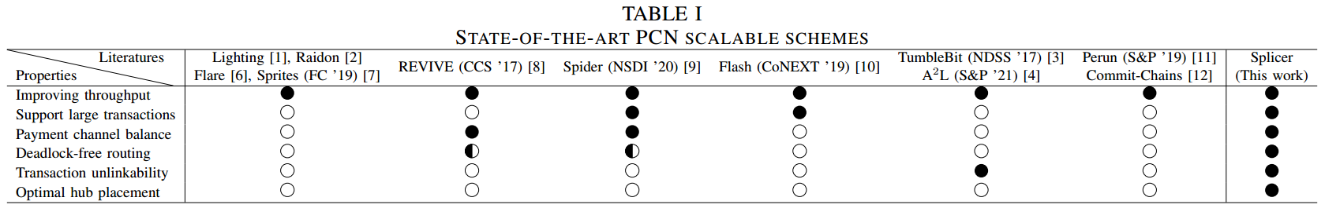
Motivation (cont.)
Why would we study the optimal PCH placement problem and deadlock-free routing ?
The existing scalable schemes mainly study the improvement of routing strategies to improve performance. The placement problem has never been discussed
Existing PCHs inherit the source routing flaw and design complex cryptographic primitives to provide unlinkability, with limited scalability improvements
PCH placement problem: Single-PCH → Multi-PCH topology & workflow & election & communication
PCH routing problem: source & single-hop routing → PCH outsourcing & multi-path routing
Notes:
This table is a compilation of the existing state-of-the-art PCN scalable solutions in our paper, and we can see that they focus on routing strategies to improve performance. The placement problem, which is the first flaw, is never discussed. The existing PCHs inherit the above source routing flaw and design complex cryptographic primitives to provide unlinkability for off-chain payments to obfuscate the relationship between the two parties of a transaction, with limited scalability improvements, which is the second flaw.
Therefore, we face two main problems: the placement and routing problems of multiple PCHs. For the placement problem, from traditional single PCH routing, we study the topology, workflow, election and communication of multiple PCHs. For the routing problem, from traditional source routing and single-pick routing, we study outsourced routing and multi-path routing for multiple PCHs.

Slide 8
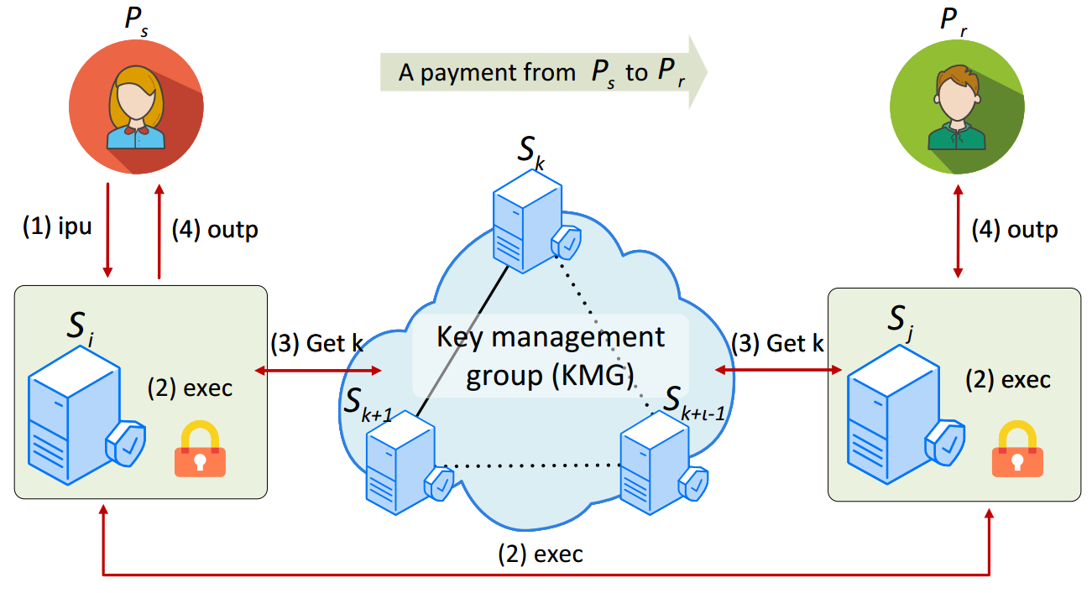
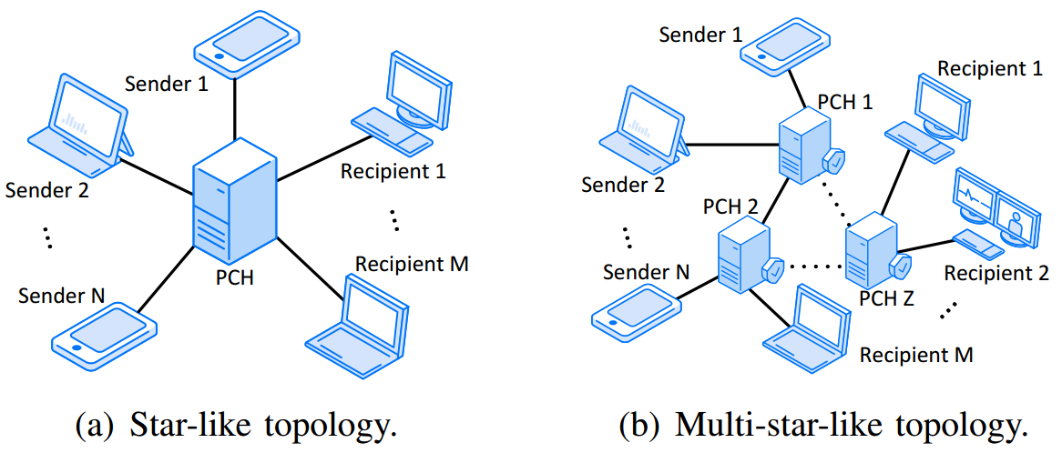
System Model
Topology & Workflow
Splicer
Smooth node
Fig. 5. PCH topologies.
Fig. 6. Workflow in multi-hop working model.
Definition 1. (Multi-star-like PCN topology). In a PCN, there are multiple PCHs connected directly or indirectly. The clients trade with each other through the PCHs that are directly connected to them.
a) Payment preparation: clients to create channels, establish secure communications, and payment initialization etc.
b) Payment execution: (1) ipu. (2) exec. (3) Get k. (4) outp.
Notes:
Next, I present the system model of our solution, including its topology and workflow. The name of our solution is Splicer, and the proposed new PCH is called a smooth node. Figure 5(a) shows the star-like topology of the existing PCHs. A PCH opens payment channels for multiple clients separately. Therefore, clients need to route single-hop through an intermediate PCH to pay each other. Figure 5(b) shows the topology of our scheme, where we model the PCN using a multi-star-like topology, where clients are evenly connected to PCHs. We define (multi-star-like PCN topology). In a PCN, there are multiple PCHs connected directly or indirectly. Clients trade with each other through PCHs that are directly connected to them. Notably, we proposed the first multi-star-like PCN with multiple PCHs.
Figure 6 illustrates the workflow of a payment from client Ps to client Pr. First the system performs payment preparation, including client creation of the channels, establishment of secure communication, and payment initialization. During the initialization process, PCH Si obtains a pair of public and private keys from the key management group (KMG) to encrypt user transactions. Then the payment execution process starts. Step (1) ipu. the user encrypts the payment request into its directly connected PCH Si. Steps (2-3) exec and Get key. Si decrypts the transaction, splits it into K transaction units, and encrypts and sends it to the directly connected PCH Sj of client Pr via multipath. The encryption process of the transaction units also involves requesting the public-private key pair from KMG. In step (4), Sj receives all the transaction units and sends the funds to Pr at once, and then Pr returns the payment acknowledgement message. This is the general flow of the system.

Slide 9
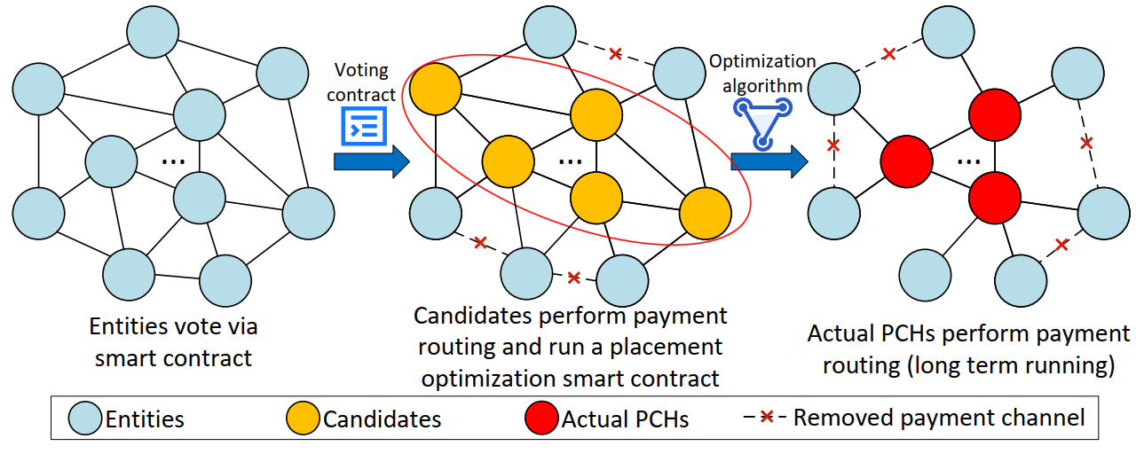
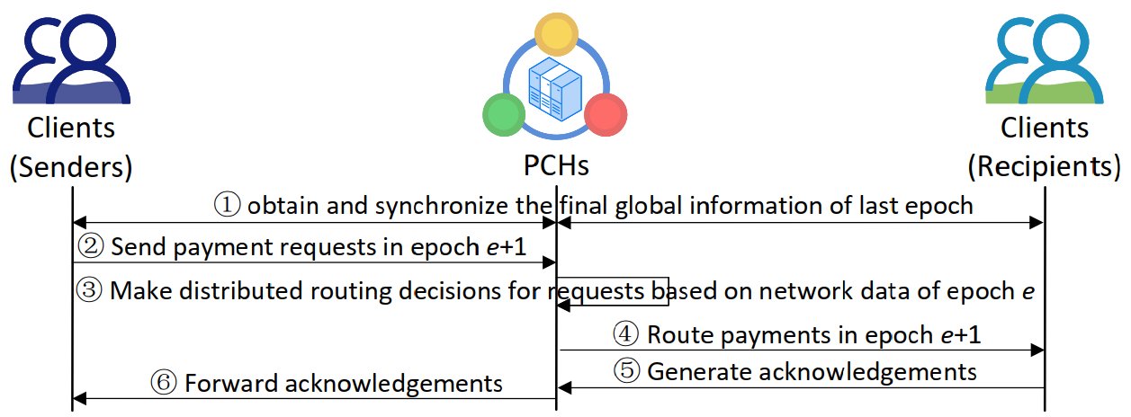
Trust & Com. Models
Trust Model
Communication Model
Fig. 7. System trust transference model.
Fig. 8. System communication process in epoch e+1.
Splicer is community-autonomous, and there is a certain trust transference between entities
A multiwinner voting algorithm allows all entities to fairly select a PCH candidate list in a long period
Candidates run a smart contract containing a placement optimization algorithm to determine the actual PCHs
Splicer runs under the bounded synchronous communication setting (in epochs)
① Synchronize the final global information of the last epoch. ② PCHs receive payment requests. ③ Each PCH makes distributed routing decisions. ④ Route payments. ⑤ Generate ACK. ⑥ Forward ACK
Notes:
We then briefly describe the trust model and communication process of Splicer. In Figure 7, Splicer runs a multi-winner voting algorithm in the smart contract (e.g., refer to the citation [17] in our paper), it efficiently allows all entities to fairly select a list of PCH candidates over a long period. The first selected candidate list of smooth nodes temporarily performs payment routing as actual PCHs. When the network state is stable, the candidate smooth nodes run a smart contract containing a placement optimization algorithm to determine the actual PCHs (long term running). Fig. 7 shows that this process is accompanied by the removal of redundant payment channels, thus reducing the complexity of the network.
The communication model is shown in Figure 8, where Splicer operates in a bounded synchronous communication setting. At the beginning of epoch e+1, PCHs obtain and synchronize the final global information of the last epoch, including clients’ states and network data (e.g., topology, channel state, payment flow rate, etc). Meanwhile, after receiving directly connected clients’ local payment requests, each PCH makes distributed routing decisions based on the network data (final global information of epoch e) and its clients’ new requests (local information of epoch e+1). Finally, recipients generate the payment acknowledgments, which PCHs forward to senders. Splicer loops the above process.

Slide 10
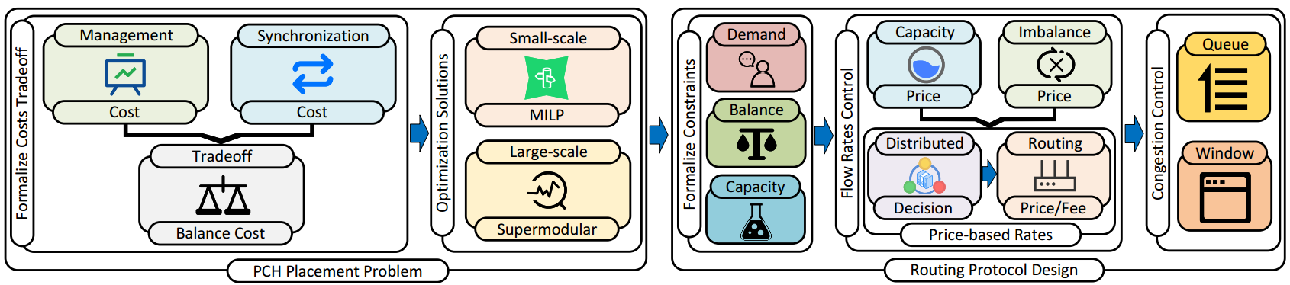
System Design Overview
The placement problem is to seek a tradeoff between routing management and synchronization costs
We formulate it as an optimization problem with two costs tradeoff and translating it into minimizing the balance cost
We provide solutions in two PCN scales for the transformed optimization problem
We give the formal constraints of the routing problem, including demand, capacity, and balance constraints
We consider the transaction flow rate control based on the routing price
We consider congestion control during routing and design the waiting queue and window to alleviate congestion
Fig. 9. The overall structure of our design.
Notes:
Next, we describe the design details of Splicer. An overview of the system design is shown in Figure 9. We first consider the placement of PCHs. The placement problem seeks a tradeoff between route management and synchronization costs. We formulate it as an optimization problem with two costs tradeoff and translate it into minimizing the balance cost. Then, we provide two PCN-scale solutions to the optimization problem.
For routing design, we first give formal constraints on the routing problem, including demand, capacity, and balance constraints. Then we consider transaction traffic control based on routing prices. We define capacity and imbalance prices, derive routing prices and costs through distributed decision making, and obtain price-based traffic. Finally, we consider congestion control during routing and design waiting queues and windows to alleviate congestion.

Slide 11
PCH Placement Problem Formalization
Goal: To select the optimal actual PCHs/Smooth Nodes from the PCH candidates
PCH placement plan
Constant cost in synchronization
② Synchronization cost between two smooth nodes
Edge-wise parameter probed at last long period
Client assignment plan
All Clients
Smooth Node Candidate
① Management cost
Weight value between the two costs
③ Balance cost
Edge-wise parameter probed at last long period
is a typical NP-hard problem
Notes:
We formalize the PCH placement problem with the aim of selecting the optimal actual PCHs from the PCH candidates. We let the binary variable x_{n} denote whether the candidate node n will be selected as a smooth node, then the vector x denotes the placement plan of the PCHs. We let y_{mn} denote whether client m is assigned to PCH n for management, then vector y denotes the assignment plan of the clients. Then, the management cost of the network can be expressed as Equation ①. The synchronization cost between two smooth nodes is denoted as Equation ②. The balance overhead that trade-offs these two costs is denoted as Equation ③. Its minimization is a typical NP-hard problem.

Slide 12

PCH Placement Problem Solution 1
Small-scale optimal solution：MILP
For ：
The linear constraints for and ：
Can be directly solved by existing commercial solvers

Large-scale
Notes:
In a small scale network, we convert the PCH placement problem into a mixed integer linear programming (MILP) problem to find the optimal solution. We use standard linearization techniques to achieve this conversion process. Thus, the PCH placement problem is converted to a MILP problem, which is represented as this formulation and can be solved directly by existing commercial solvers.
However, our model involves the payments of mobile or IoT devices, and the scale of the PCNs may be very large, leading to an extremely large MILP problem, creating a bottleneck in the solvers’ computational performance. Hence we overcome this problem by proposing an approximation solution to solve the large-scale problem.

Slide 13
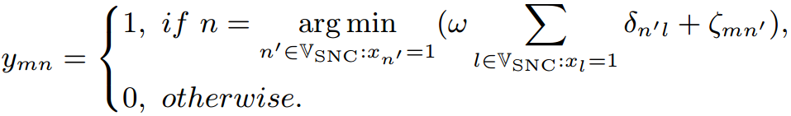
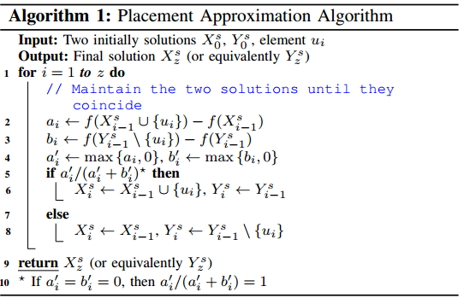
PCH Placement Problem Solution 2
Large-scale optimal solution：Supermodular
Definition 2. Given a finite set S, a set function
is called supermodular if for all subsets with
and every element it holds that
Lemma 1. Given a placement plan x, for each , the optimal assignment plan y can be expressed as
Lemma 2. The set function is supermodular for the case of uniform costs , .
The set of all possible placements of smooth node:
The balance cost objective function:
Notes:
First, we introduce a lemma that reveals the relationship between the placement plan x and the assignment plan y. It shows that it is easy to find the optimal assignment plan y for a given placement plan x. The set of all possible placements of a smooth node is shown below. The objective function of the balance cost is translated into this equation. Next, we consider a well-studied class of set functions, called supermodular, as defined in Definition 2. We give Lemma 2 and the placement problem is transformed into minimizing the supermodular function f. It can be solved by a greedy approximation algorithm.

Slide 14
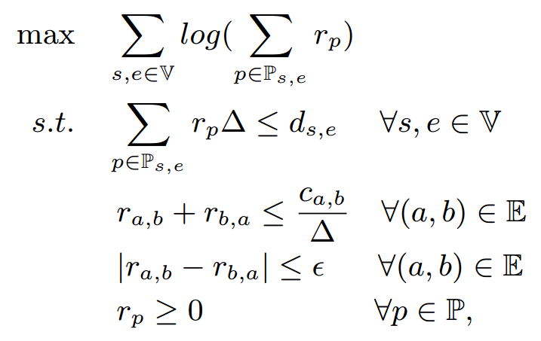
Deadlock-Free Routing Protocol
Multi-path deadlock-free routing formulation:
Utility: logarithm of the total payment rate
Demand constraint
Capacity constraint
Balance constraint
These three constraints can reduce PCN deadlocks as much as possible
Notes:
With the placement problem out of the way, we now briefly describe the routing protocol we designed on the PCH. The goal of routing is to ensure that the channel funds in the network are fully utilized. Therefore, we model the total payment rate to seek maximization of utility. The demand constraint ensures that the total flow of all paths is no more than the total demand. The capacity constraint limits the upper bound of the flow rate. The balance constraint ensures that the flow rates in both directions of the channel are nearly equal. Therefore these three constraints can reduce PCN deadlocks as much as possible.

Slide 15
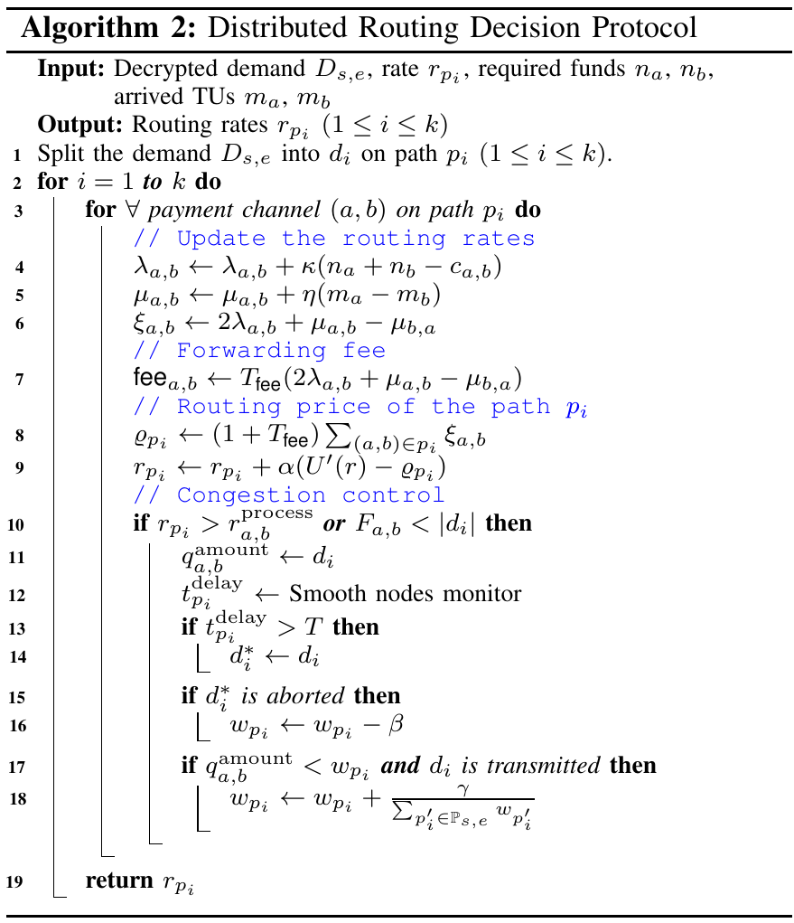
Deadlock-Free Routing Protocol (cont.)
Capacity price
Imbalance price
Routing price (on a channel)
Forwarding fee
Routing price on a payment path
Payment rate adjustment
Queue window adjustment
Notes:
In the following, we introduce the distributed routing algorithm. To calculate the fee used to control the flow rate, we assign a routing price to the channel. It consists of a capacity price and an imbalance price. The capacity price corresponds to the capacity constraint. The imbalance price corresponds to the balance constraint. Thus, the forwarding fee set according to these two prices also satisfies the constraints we define. Finally, the purpose of adjusting the payment rate is achieved to reduce the possibility of deadlock. In addition, congestion control further controls the window of the transaction queue, making the network almost deadlock-free.

Slide 16
Performance Evaluation
Experiment Setup
A simulation using MATLAB and full implementation of the Lightning Network Daemon (LND) testnet
A small-scale network (100 nodes) and a large-scale network (3000 nodes)
Referring to Spider’s evaluation benchmark [4], the channel connections are generated by ROLL [5]
Lightning Network real-world dataset & credit card dataset adopted by Spider
Baseline Schemes
Spider: a multi-path source routing scheme
Flash: a modified max-flow algorithm to find paths for large payments [6]
Landmark: a routing algorithm adopted by many PCN schemes [7][8]
A2L: the state-of-the-art PCH that focuses on providing unlinkability [9]
[4] V. Sivaraman, et al, “High throughput cryptocurrency routing in payment channel networks,” in NSDI, 2020.
[5] A. Hadian, Q. Qu, et al, “ROLL: Fast In-Memory Generation of Gigantic Scale-free Networks.” in SIGMOD, 2016.
[6] P. Wang, et al, “Flash: efficient dynamic routing for offchain networks.” in CoNEXT, 2019.
[7] G. Malavolta, et al, “Silentwhispers: Enforcing security and privacy in decentralized credit networks.” in NDSS, 2017.
[8] S. Roos , et al, “Settling payments fast and private: Efficient decentralized routing for path-based transactions.” in NDSS, 2018.
[9] E. Tairi , et al, “A2L: Anonymous Atomic Locks for Scalability in Payment Channel Hubs,” in S&P, 2021.
Notes:
Our evaluation includes simulations using MATLAB and a complete implementation of the Lightning Network Daemon (LND) test network. We model the PCN at two scales, one for small networks (100 nodes) and the other for large networks (3000 nodes). The directed distribution for each transaction is generated on our processed Lightning Network real-world dataset, while the transaction values are generated on the same credit card dataset used by Spider. Note that we have confirmed that these transactions definitely cause some local deadlocks and contain large transactions that the Lightning Network cannot handle.

Slide 17
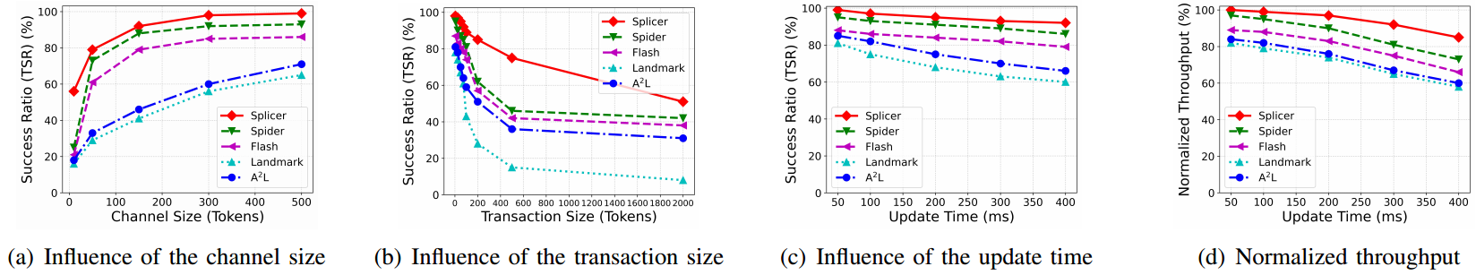
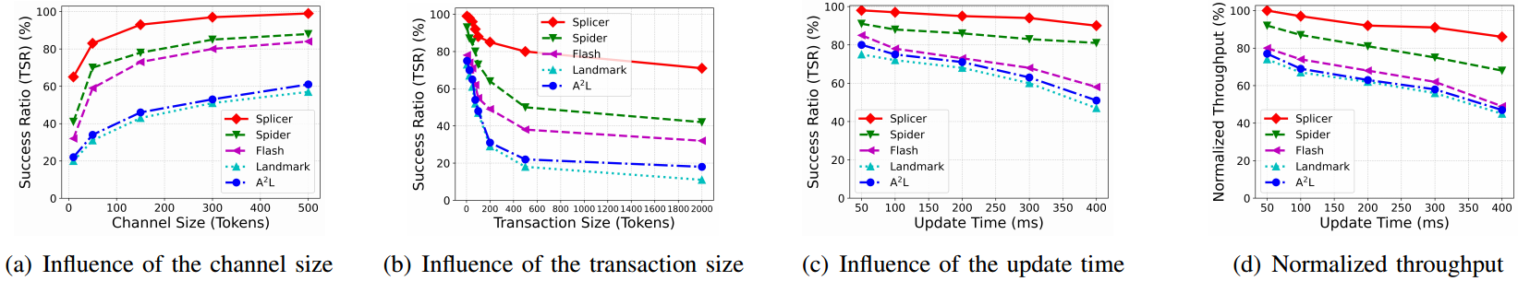
Results
The comparison between Splicer and other schemes under different metrics
Fig. 10. The comparison between Splicer and other schemes under different metrics in small-scale networks.
Splicer achieves an average improvement of about 50% in transaction success rate and about 30% in transaction throughput over existing schemes
Fig. 11. The comparison between Splicer and other schemes under different metrics in large-scale networks.
Notes:
First, we compare Splicer with other solutions under different metrics. The main vertical axis metrics are transaction success rate and normalized throughput. Transaction Success Rate (TSR) is the number of completed transactions divided by the number of generated transactions. a high TSR value indicates the stability of the model, i.e., its ability to handle transaction deadlocks and balance the network load. Standardized throughput is the ratio of the total value of completed payments to the total value of generated ones, normalized by the maximum throughput. The high throughput demonstrates the model's ability to perform a large number of concurrent transactions, further corroborating the TSR and proving the stability of the model. The horizontal axis metrics include channel size, transaction size, and network cycle update time. Figure 6 and Figure 7 show the comparison results at small and large scale, respectively. The results show that, overall, Splicer achieves an average improvement of about 50% in transaction success rate and about 30% in transaction throughput over existing schemes. These results show that Splicer can significantly improve performance scalability compared to existing techniques. In large-scale networks, the performance improvement of Splicer is even more significant. In addition, subsequent results show that Splicer's layout optimization results in smaller communication costs. Therefore, we recommend the use of Splicer in large-scale low-power scenarios.

Slide 18
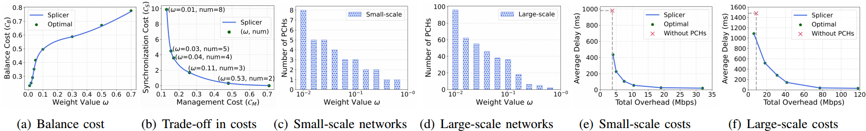
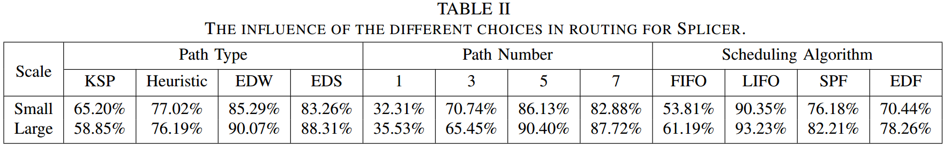
Results (cont.)
Evaluation of PCH placement
Fig. 12. Evaluation of smooth node placement.
Splicer's different routing choices
Notes:
Figure 8 shows the results of the evaluation of the PCH placement problem, and Table 2 shows the different routing scenarios of Splicer. Due to time limitations, I won't describe it in detail.

Slide 19
Contribution and Conclusion
We propose a distributed routing mechanism with high scalability based on multiple PCHs
We seek a new tradeoff between decentralization and scalability for PCNs
PCHs route transaction flows in an optimal deadlock-free manner
We formulate the PCH placement problem for network scalability and propose two solutions in small and large-scale networks
We design the rate-based routing and congestion control protocols on PCHs
Extensive experimental results show that Splicer outperforms the state-of-the-arts
Notes:
We propose a distributed routing mechanism with high scalability based on multiple PCHs to find a new compromise between decentralization and scalability of PCNs. PCHs route transaction flows in a PCN in an optimal deadlock-free manner. We formulate the PCH placement problem for network scalability and propose two solutions for small and large networks. To improve performance scalability, we design rate-based routing and congestion control protocols over PCHs. Extensive experimental results show that Splicer outperforms state-of-the-art techniques.

Slide 20
Thanks
NSS Lab @ XDU
https://nss.xidian.edu.cn/
Email: lxyang@stu.xidian.edu.cn
Notes:
That concludes my report, thank you all.

